Slide 1
Anomaly In Stream
Instructor: Dr. Kangavari
Presenter: M. Doosti Lakhani
Robust Random Cut Forest Based Anomaly Detection On Streams

Slide 2
What We Will Cover
Intro
Why stream data
Main challenge
Study case: Anomaly detection
What is anomaly?
Importance of anomaly detection
Synopsis of input data
Updating synopsis efficiently
Ensemble of RRCTs
Viability

Slide 3
1 Intro
Why stream data
Main challenge

Slide 4

1.1 Why Stream Data
All data originates in real time
Image segmentation, Language modeling
Emerging explosion of IoT and internet, rejuvenated the well-studied problems such as anomaly detection
We are dealing with it in everyday tasks

Slide 5
1.2 Main Challenge
Insights are perishable
Batch analytics operations take too long
Data originated
Maximizes value
Analytics performed
Business value
Time to action
Insights obtained (outdated)
Decision made (Poor decisions)
Action taken (impotent)

Slide 6
1.2 Main Challenge cont.
What we want:
Ingest data as it it’s generated
Process data on the fly
Real time machine learning
Robust Random Cut Forest

Slide 7
2 Study Case
What is anomaly?
Importance of anomaly detection
Synopsis of input data
Algorithm
Examples
Definition of Anomaly in RCF
Classic Shortcomings
Updating synopsis efficiently
Viability

Slide 8
2.1 What Is Anomaly?
Anomaly is an observation that diverges from otherwise well-structured data
Outlier, exception or anything that deviates from normal pattern
Model based perspective: A point is anomaly, if it increases the complexity of model
In case of trees, creating new leaves in early stages
Far from what has been learned, easier isolation

Slide 9
2.2 Importance of Anomaly Detection
Anomalies need to be responded fast and accurately
A anomalous behavior in a patience gathered from their smart watch
Finding a failure in network systems
…

Slide 10
2.3 Synopsis of input data
Algorithm
Examples
Definition of Anomaly in RCF
Classic Shortcomings
Ensemble of RRCTs
Viability

Slide 11

2.3.1 Algorithm
RRCT
Unsupervised
Very fast on high dimensional data
A Robust Random Cut Tree on point set $S$
Choose a random dimension proportional to: $\frac{l_{i}}{\sum_{j}{l_{j}}}$ where $l_{i}=\max\left(x_{i}\right)−\min\left(x_{i}\right)$
Choose $X_{i}\sim uniform(\min\left(x_{i}\right), \max\left(x_{i}\right))$
Let $S_{1}=\left\{x | x ∈S, x_{i}<X_{i}\right\}$ and $S_{2}=\frac{S}{S_{1}}$ and recurse on $S_{1}$ and $S_{2}$

Slide 12
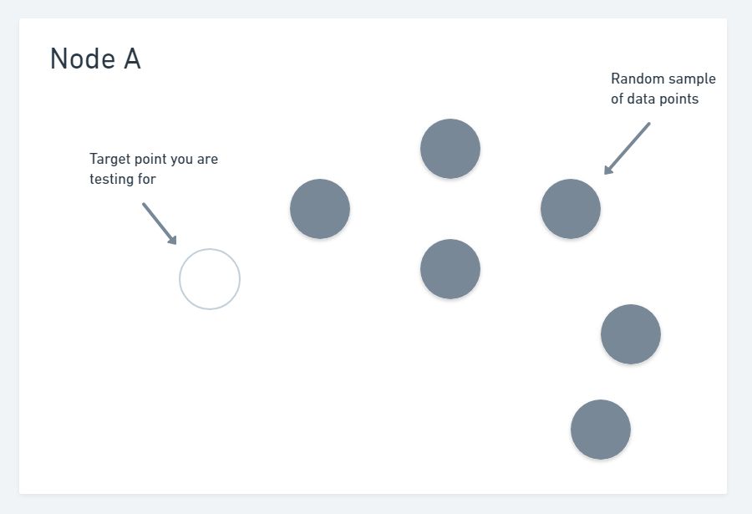
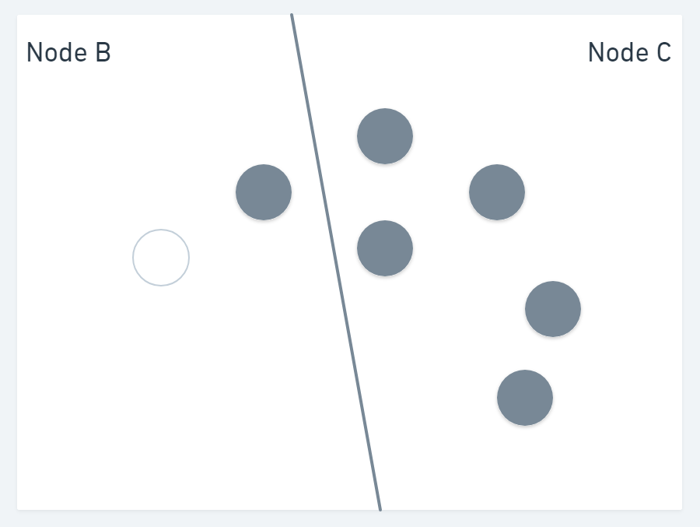
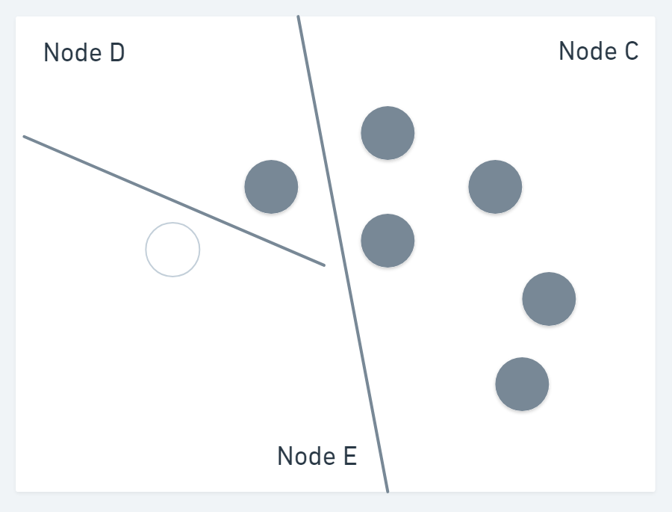
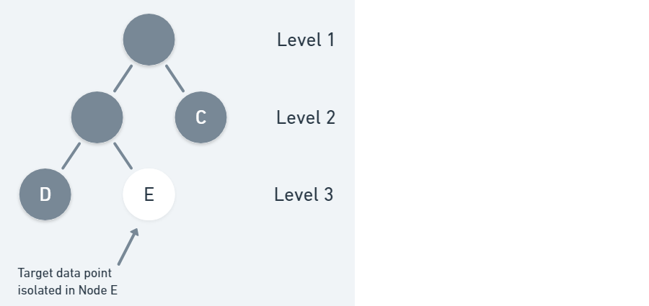
2.3.2 Examples

Slide 13
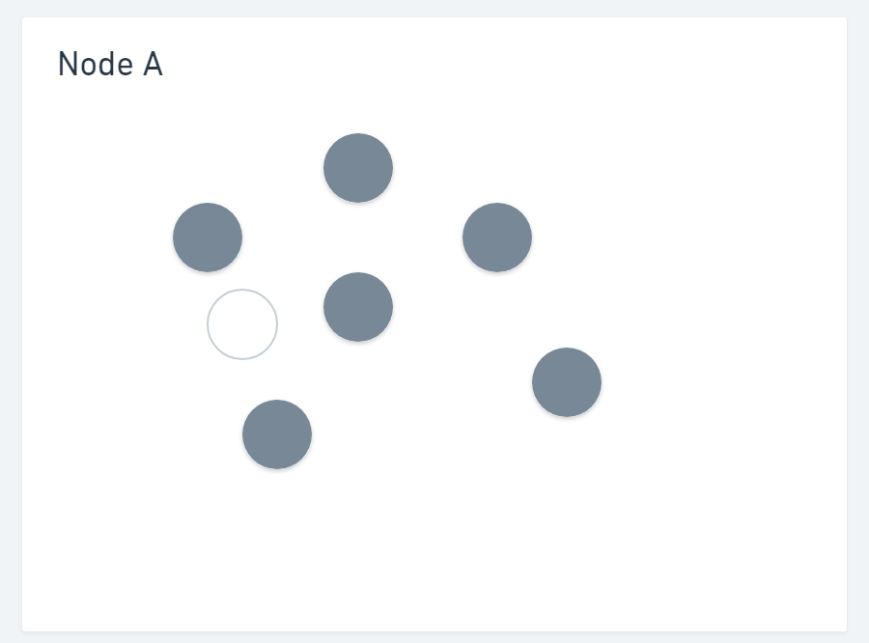
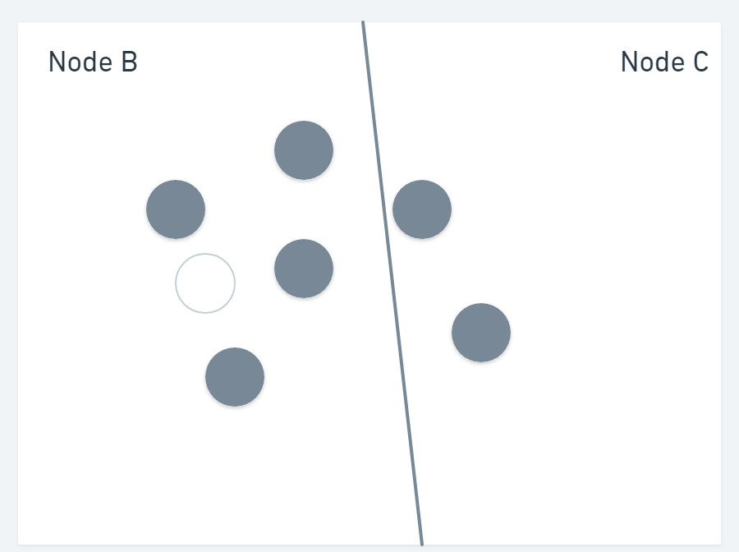
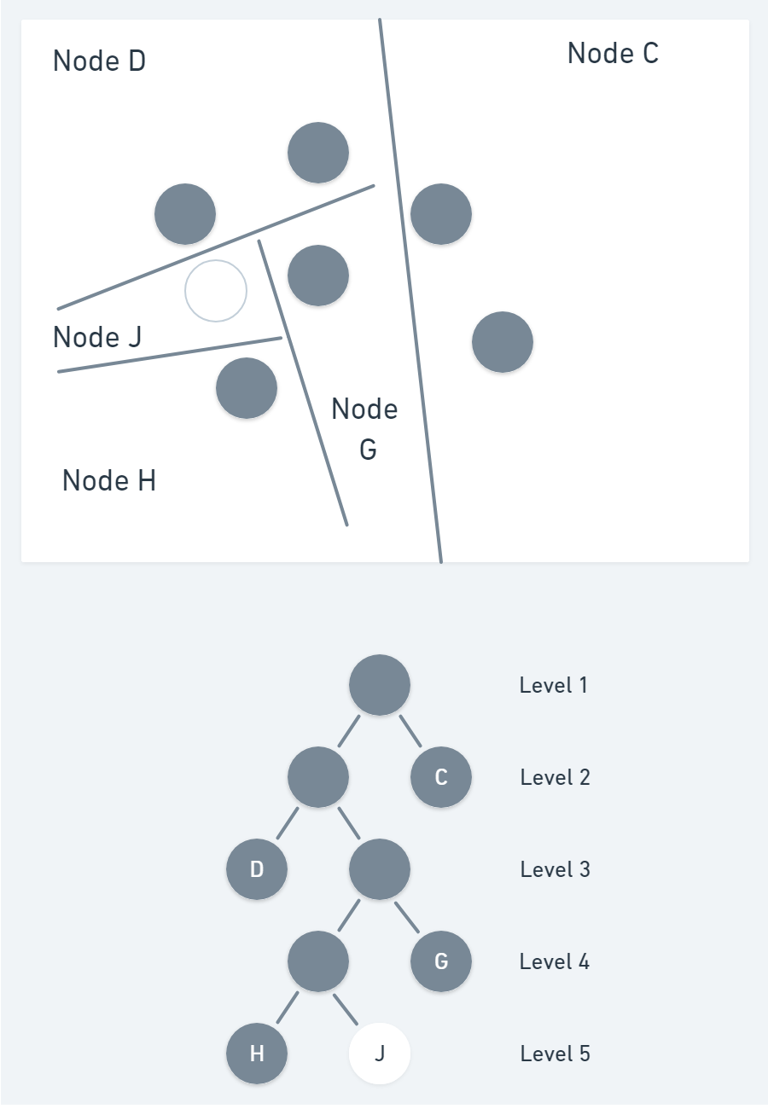
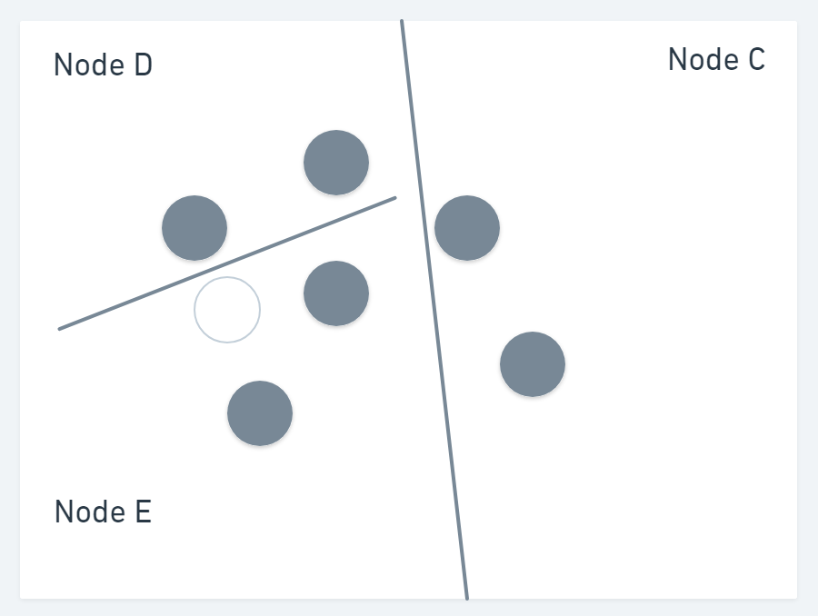
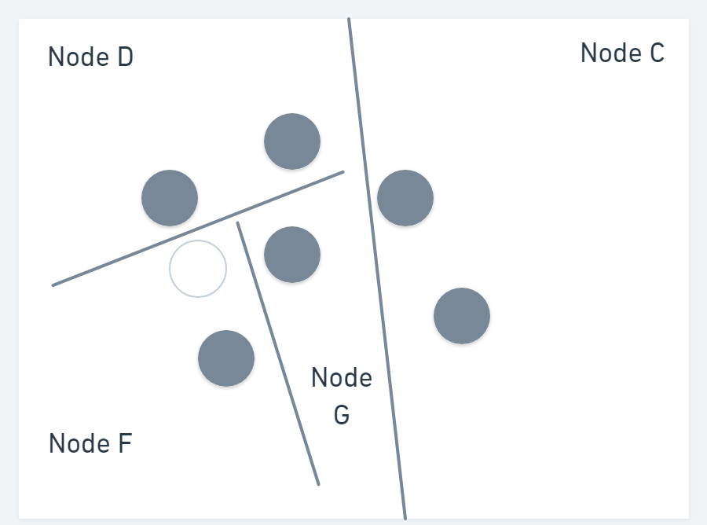
2.3.2 Examples cont.

Slide 14
2.3.3 Definition of Anomaly in RCF
Anomaly points are isolated much faster and they will be on top of the tree
The points near the root will get higher score
The score is distance based, so the points far from normal clusters get higher score (nearer to root)
So a point will be anomaly if it increases the size of tree profoundly.
Same idea has been used for test
If test node is near to root, then it is probably an anomaly
If a point is far in from data in N-dim data, it will be as far relatively in RCF

Slide 15
2.3.4 Classic Shortcomings
Classic approaches such as thresholding peaks for detecting anomalies were not successful
Could not be adopted from one task to another
Could not fit the nature of stream data
It needed expert which is against the automation!

Slide 16

2.4 Updating synopsis efficiently
If we delete a node containing a isolated point $x$, and its parent, then the resulting tree has the same probability if it is being drawn without $x$
By extending previous theorem, we can construct a tree without $x$ but by adding it after construction.
Typically, if we build a tree and insert a node and then delete it again, the result will be almost the same and preserves the distribution.
This enables the adaption in stream learning

Slide 17

2.4 Updating synopsis efficiently cont.
We can maintain a random tree over s sample set even as the sample is updated dynamically for streaming data using sublinear update time $O\left(d\left|S\right|\right)$
For sliding window over data, we can think of removing a node and adding other nodes.
Removing nodes can be done by deleting nodes with lower priority
As we do this uniformly, we can think of last recently used as the choice.
Based on the theorem in previous slide, we can efficiently answer this question that what would happen if we add arbitrary point $p$ but constructing its tree.
Inserting is like constructing the tree with $p$ from the beginning.

Slide 18

2.5 Ensemble of RRCTs
Those theorems can be expanded to include in ensemble case:
The probability of choosing a random cut that splits $S$ is exactly same as the conditional probability of choosing a random cut that splits $S \bigcup{ \{p\}}$ conditioned on not isolating $p$ from all points of $S$
Insertion, deletion also follow same definitions

Slide 19
2.6 Viability
New York taxi ridership
Shingling data
Each time stamp as a different feature for a window with stride of 1
It can capture typical shape, any departure can be interpreted as anomaly
Data collected for 7 months
Data is 1-dimensional but by shingling, they include current day and last day, so 48 dimensions
Special days as anomaly
Accuracy 96 and AUC 0.9

Slide 20
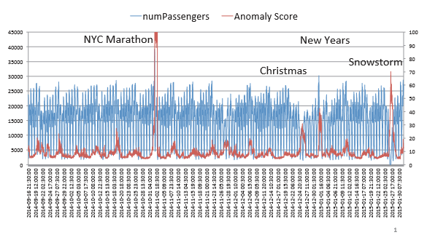
2.6 Viability cont.

Slide 21
2.6 Viability cont.
Amazon SageMaker: A production level implementation of RCF, currently available in AWS clouds using native implementation
Link to official docs
Official open source project on Github

Slide 22
References
Guha, Sudipto, et al. "Robust random cut forest based anomaly detection on streams." International conference on machine learning. 2016.
Wagner, Tal, et al. "Semi-supervised learning on data streams via temporal label propagation." International Conference on Machine Learning. 2018.
Eswaran, Dhivya, et al. "Spotlight: Detecting anomalies in streaming graphs." Proceedings of the 24th ACM SIGKDD International Conference on Knowledge Discovery & Data Mining. 2018.
Images are barrowed from Manning Publications

Slide 23
The end Thank you

